Slide 1
Cryptography
Lecture 6
Vahid Amin-Ghafari
Vahidaming@ustc.edu.cn

Slide 2
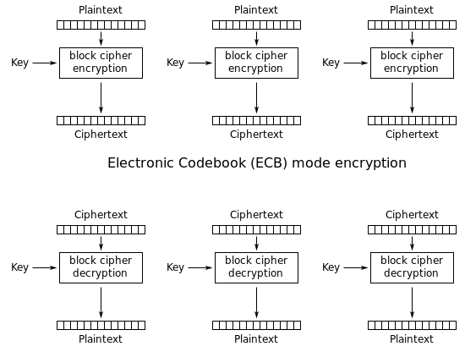
Block cipher mode of operation
Electronic
Codebook
(ECB):

Slide 3
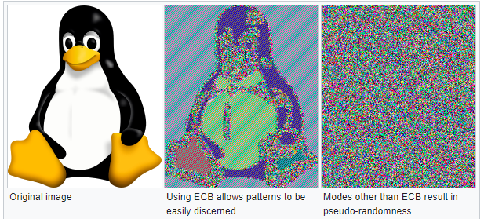
Block cipher mode of operation

Slide 4
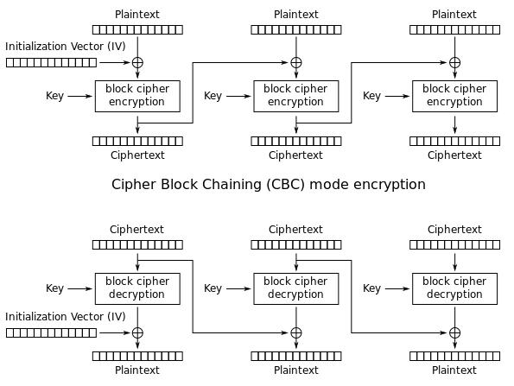
Block cipher mode of operation
Cipher
block
Chaining
(CBC)

Slide 5
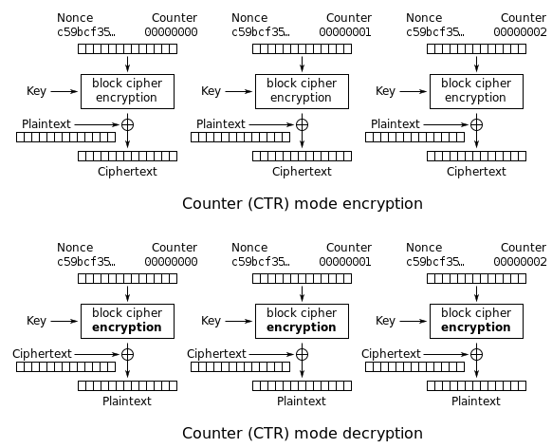
Block cipher mode of operation
Counter
(CTR)

Slide 6
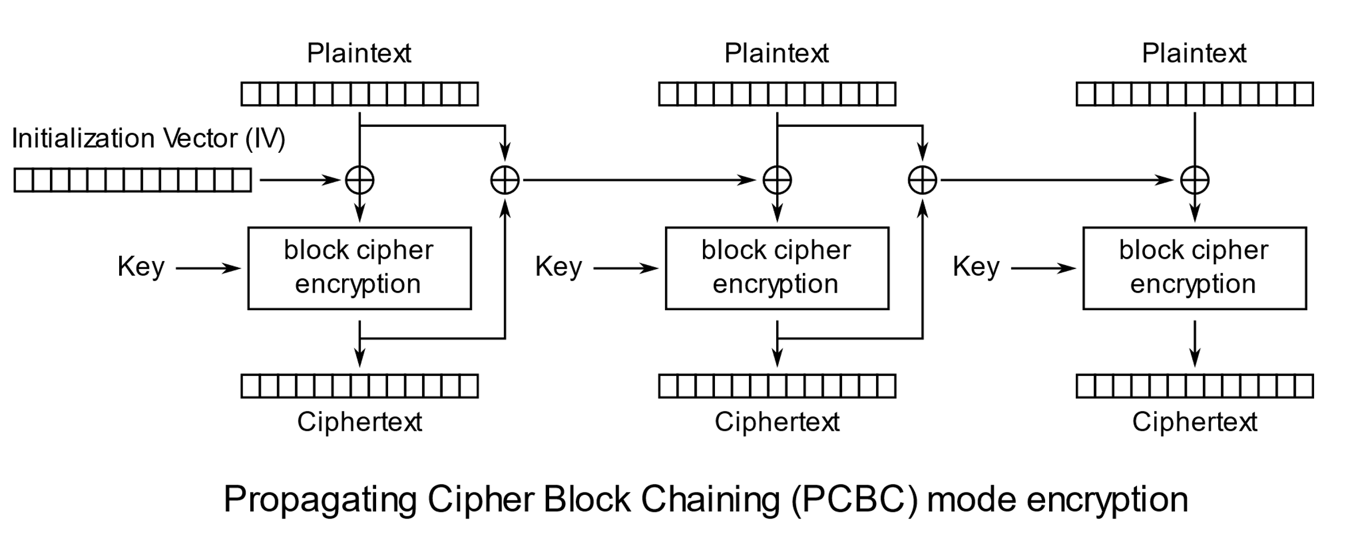
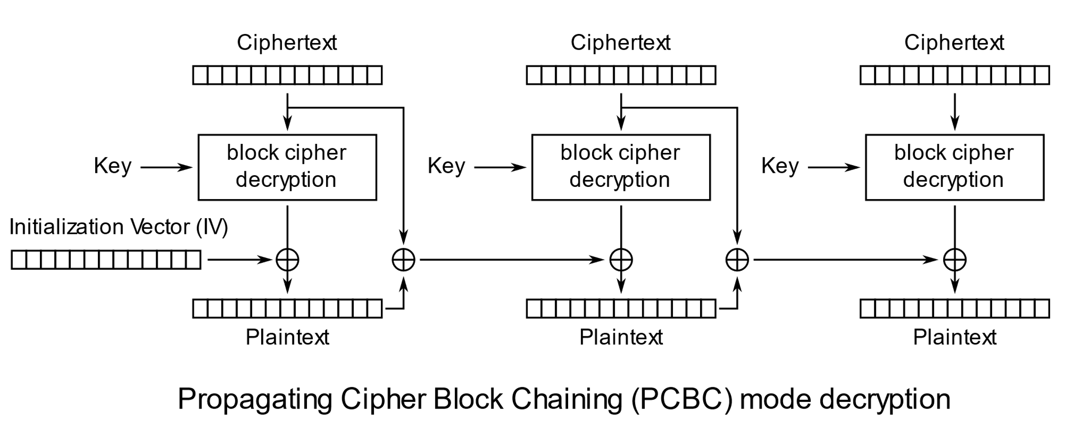
Block cipher mode of operation
Propagating cipher block chaining (PCBC)

Slide 7
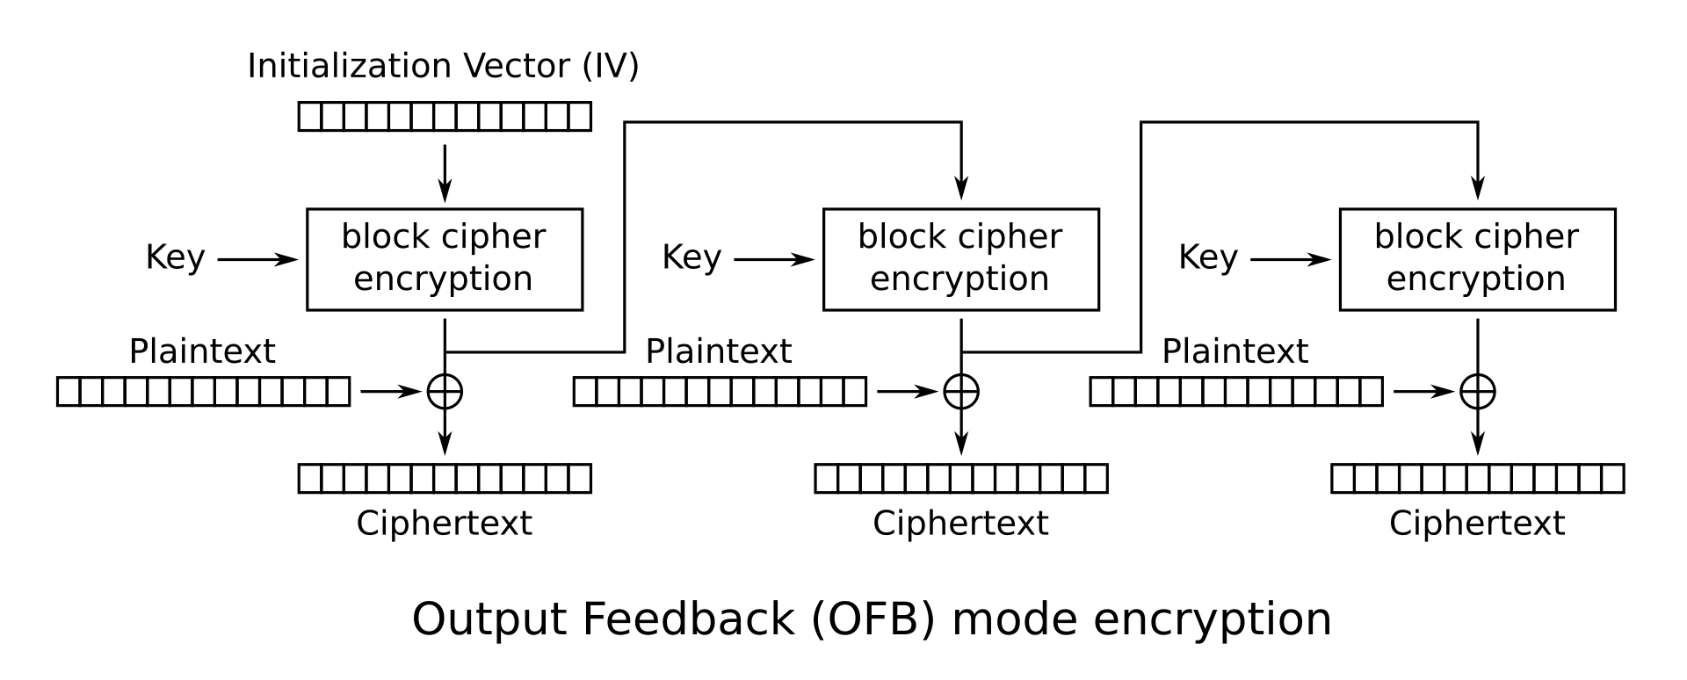
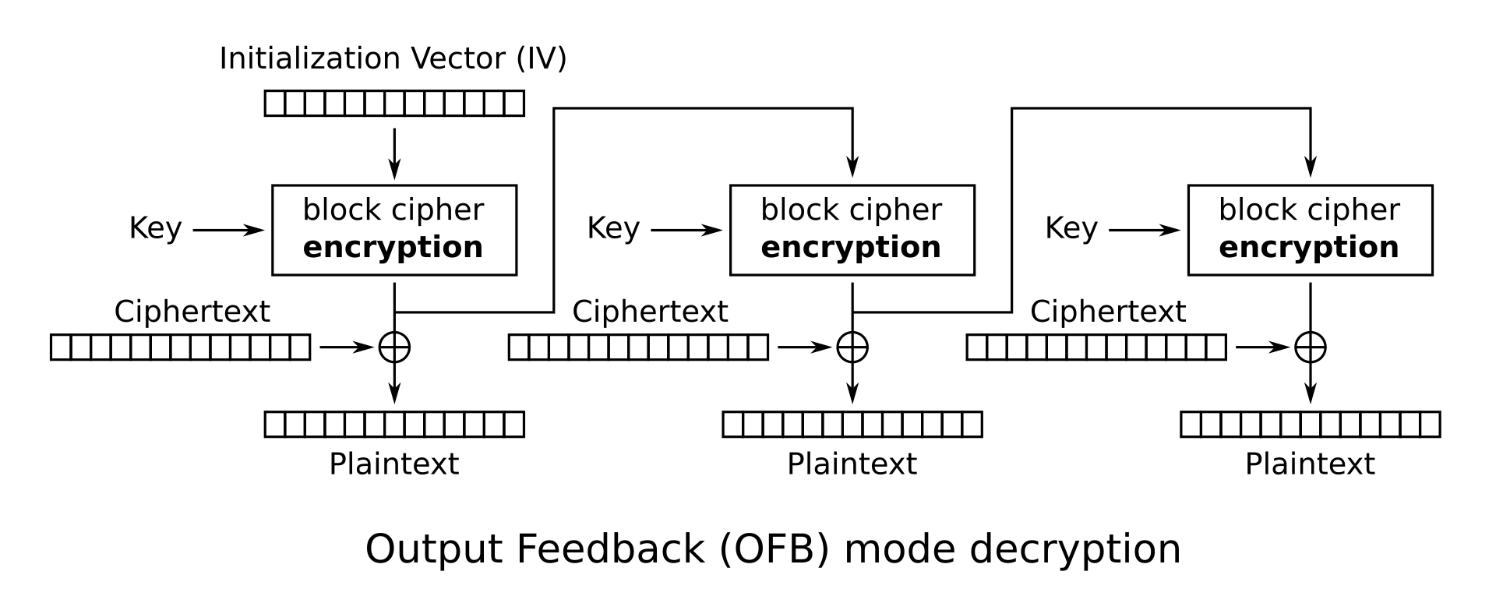
Block cipher mode of operation
Output feedback (OFB)

Slide 8
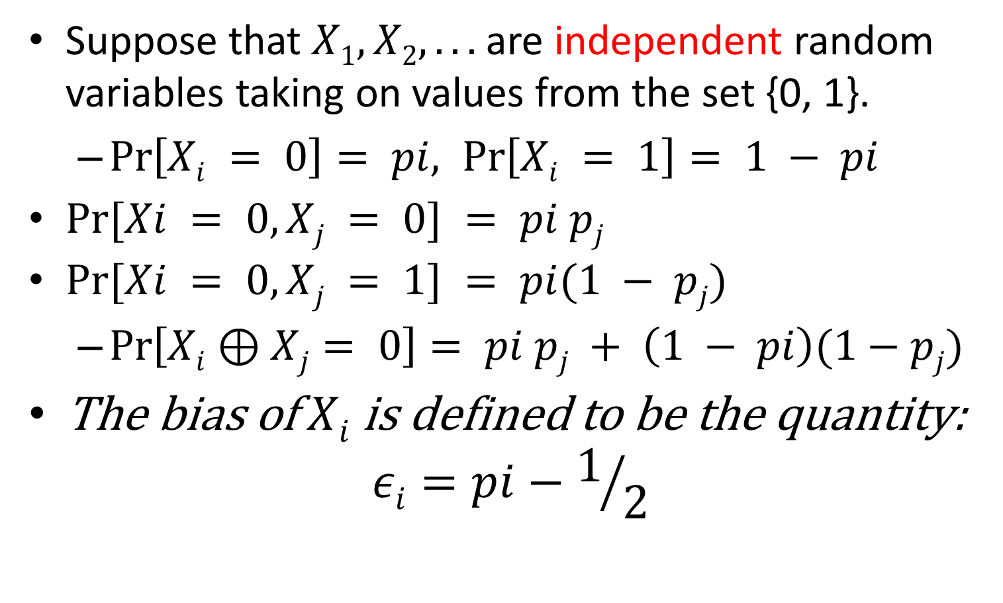
Bias
Suppose that $X1, X2, . . .$are independent random variables taking on values from the set {0, 1}.
$\operatorname{Pr}\left[Xi = 0\right]= pi, \operatorname{Pr}\left[Xi = 1\right]= 1 − pi$
$Pr⁡[Xi = 0, Xj = 0] = pi pj$
$Pr⁡[Xi = 0, Xj = 1] = pi(1 − pj)$
$\operatorname{Pr}\left[Xi⊕Xj= 0\right]= pi pj + \left(1 − pi\right)(1−pj)$
The bias of $Xi$is defined to be the quantity:
$$εi=pi−1/2$$

Slide 9
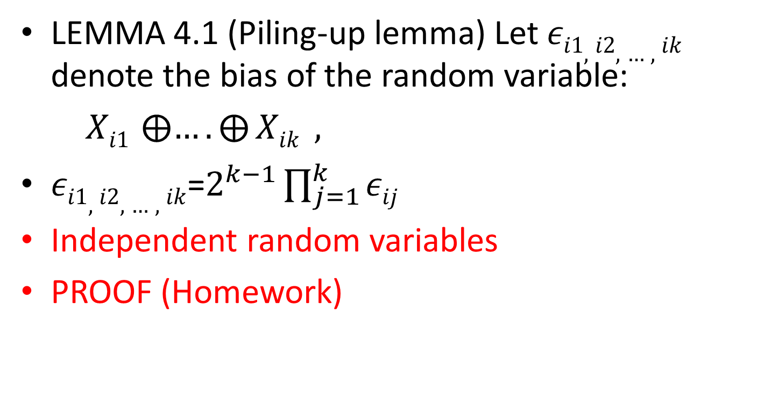
Piling-up lemma
LEMMA 4.1 (Piling-up lemma) Let $εi1,i2,…,ik$ denote the bias of the random variable:
$Xi1 ⨁{….}⨁{Xik} ,$
$εi1,i2,…,ik$=$2^{k−1}\prod_{j=1}^{k}{εij}$
Independent random variables
PROOF (Homework)

Slide 10
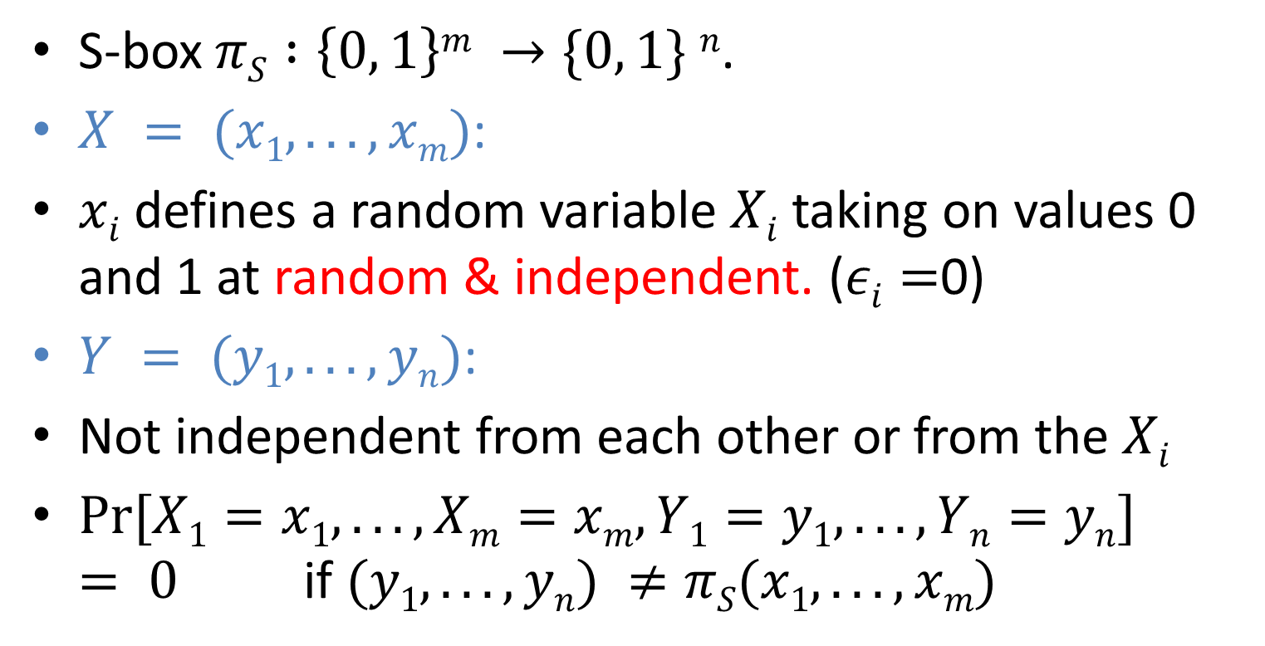
Linear Approximations of S-boxes
S-box $πS :\left\{0, 1\right\}m →\{0, 1\} n$.
$X = (x1, . . . , xm)$:
$xi$ defines a random variable $Xi$ taking on values 0 and 1 at random & independent. ($εi=$0)
$Y = (y1, . . . , yn)$:
Not independent from each other or from the $Xi$
$Pr⁡[X1=x1, . . . ,Xm=xm,Y1=y1, . . . ,Yn=yn] = 0$ if $(y1, . . . , yn) ≠πS(x1, . . . , xm)$

Slide 11
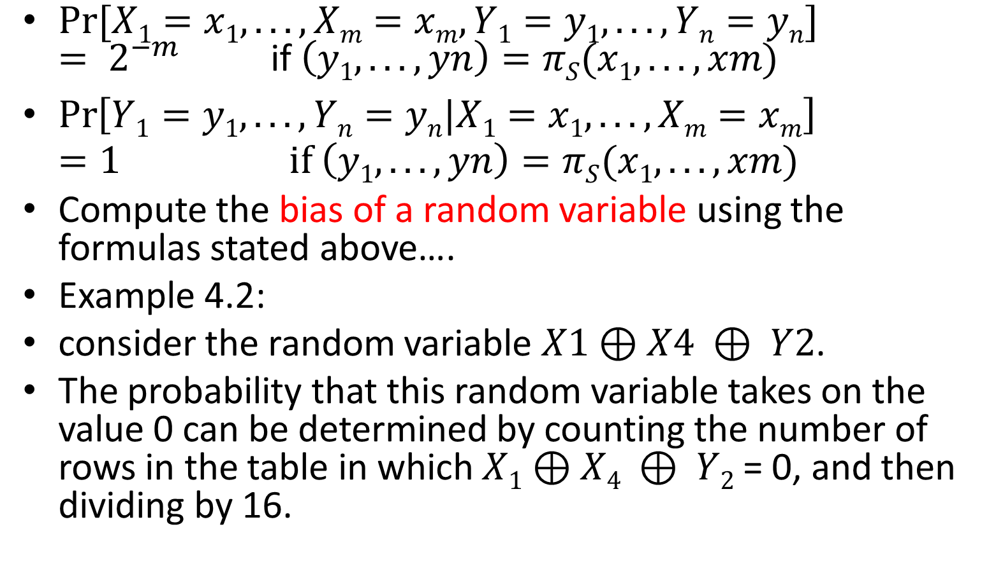
Linear Approximations of S-boxes
$Pr⁡[X1=x1, . . . ,Xm=xm,Y1=y1, . . . ,Yn=yn] = 2^{−m}$ if $\left(y1, . . . , yn\right)=πS(x1, . . . , xm)$
$\operatorname{Pr}\left[Y1=y1, . . . ,Yn=yn|X1=x1, . . . ,Xm=xm\right]=1 if \left(y1, . . . , yn\right)=πS(x1, . . . , xm)$
Compute the bias of a random variable using the formulas stated above….
Example 4.2:
consider the random variable $X1⊕X4 ⊕ Y2$.
The probability that this random variable takes on the value 0 can be determined by counting the number of rows in the table in which $X1⊕X4 ⊕ Y2$= 0, and then dividing by 16.

Slide 12
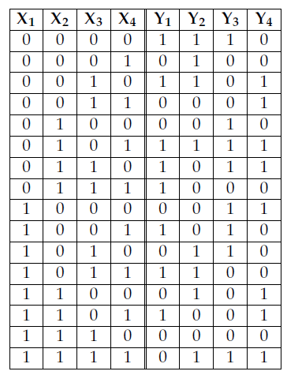
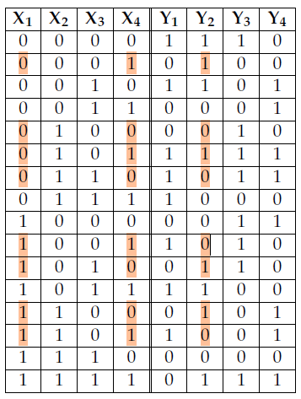
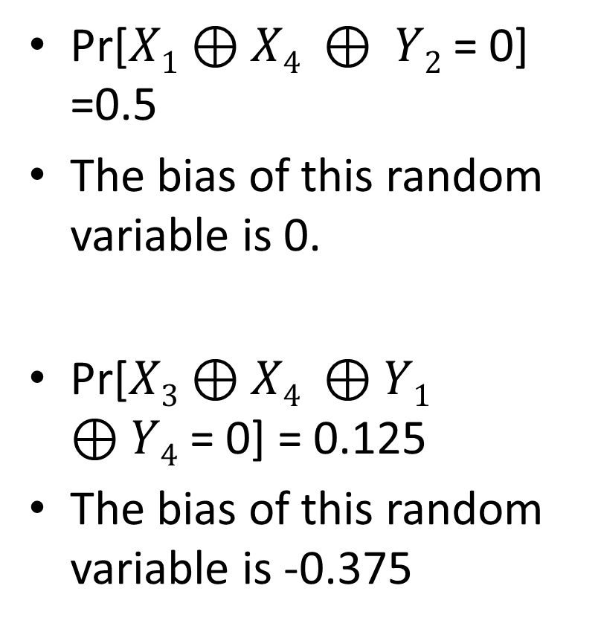
Random variables defined by an S-box
Pr[$X1⊕X4 ⊕ Y2$= 0] =0.5
The bias of this random variable is 0.
Pr[$X3⊕X4 ⊕Y1 ⊕Y4$= 0] = 0.125
The bias of this random variable is -0.375

Slide 13

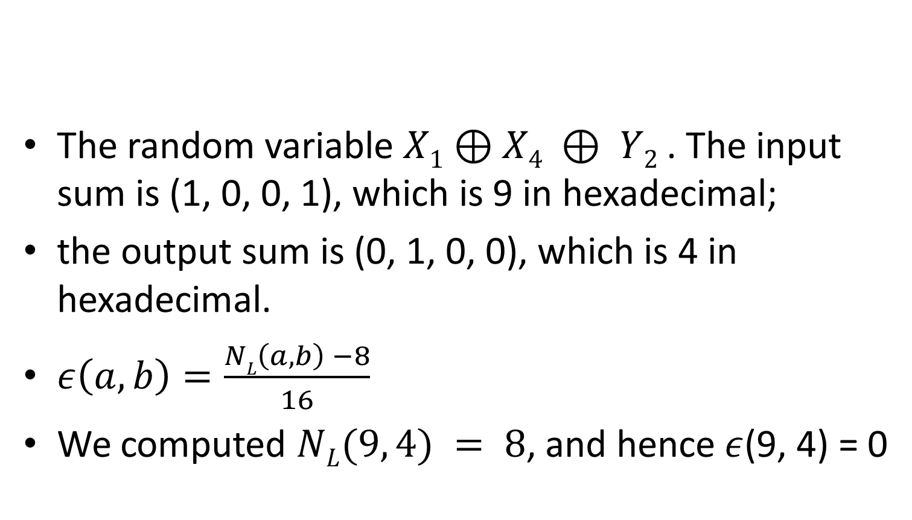
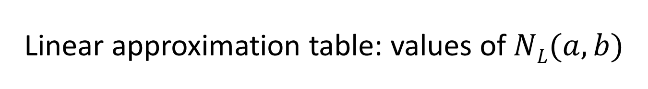
Linear approximation table: values of $NL(a, b)$
The random variable $X1⊕X4 ⊕ Y2$. The input sum is (1, 0, 0, 1), which is 9 in hexadecimal;
the output sum is (0, 1, 0, 0), which is 4 in hexadecimal.
$ε\left(a, b\right)=\frac{NL\left(a, b\right) −8}{16}$
We computed $NL(9, 4) = 8$, and hence $ε$(9, 4) = 0

Slide 14
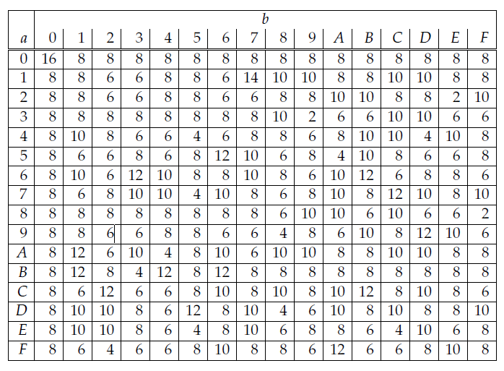
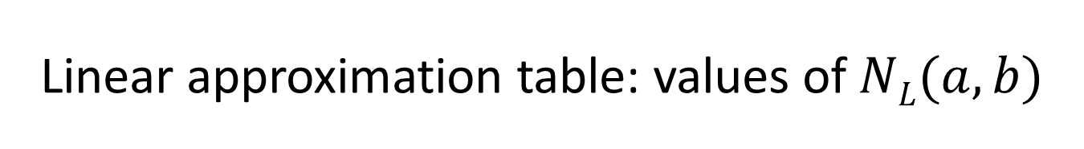
Linear approximation table: values of $NL(a, b)$

Slide 15
Linear Cryptanalysis: informally describing
Find a probabilistic linear relationship between a subset of plaintext bits and a subset of state bits immediately preceding the substitutions performed in the last round.
There exists a subset of bits whose exclusive-or behaves in a non-random fashion (it takes on the value 0, say, with probability bounded away from 1/2).
Assume that an attacker has a large number of plaintext-ciphertext pairs, all of which are encrypted using the same unknown key K (i.e., we consider a known-plaintext attack)

Slide 16
Linear Cryptanalysis
For each of the plaintext-ciphertext pairs, we will begin to decrypt the ciphertext, using all possible candidate keys for the last round of the cipher.
For each candidate key, we compute the values of the relevant state bits involved in the linear relationship, and determine if the abovementioned linear relationship holds.

Slide 17
Linear Cryptanalysis
Whenever it does, we increment a counter corresponding to the particular candidate key.
At the end of this process, we hope that the candidate key that has a frequency count furthest from 1/2 times the number of plaintext-ciphertext pairs contains the correct values for these key bits.

Slide 18
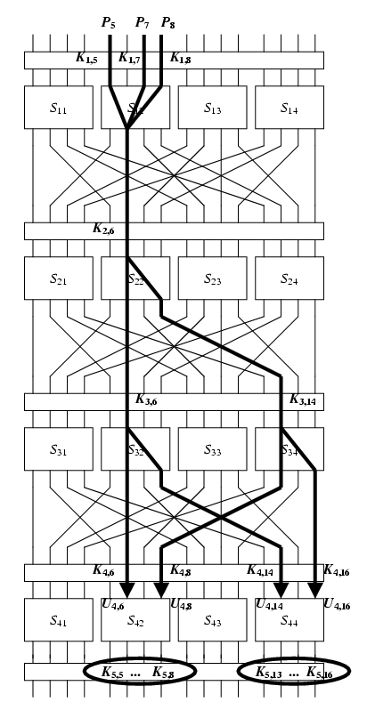
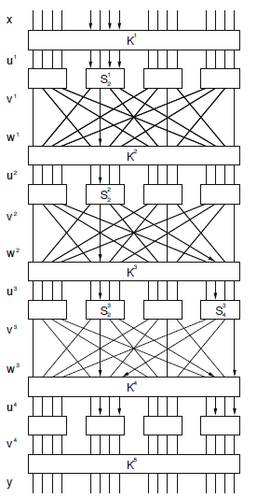
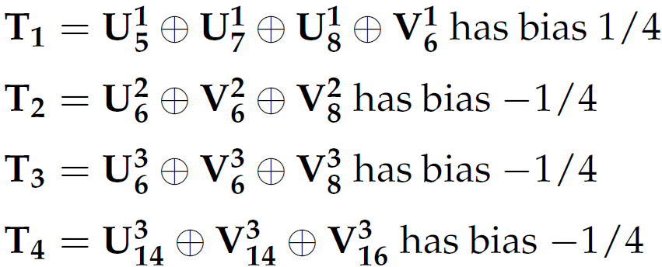
Lines with arrows correspond to random variables that will be involved in linear approximations.
The labeled Sboxes are the ones used in these approximations (active S-boxes)
x
u¹
v¹
w¹
u²
v²
w²
u³
v³
w³
u⁴
v⁴
y

Slide 19
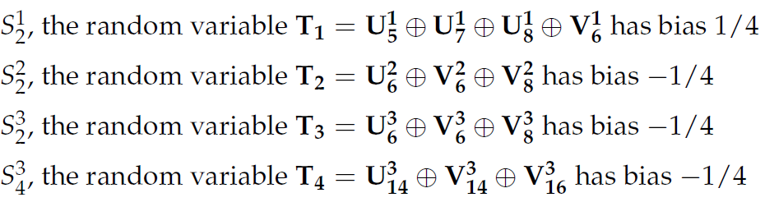
Linear Cryptanalysis
Approximation incorporates four active S-boxes:
If we make the assumption that these four random variables are independent, then we can compute the bias of their x-or using the piling-up lemma (independent?)

Slide 20
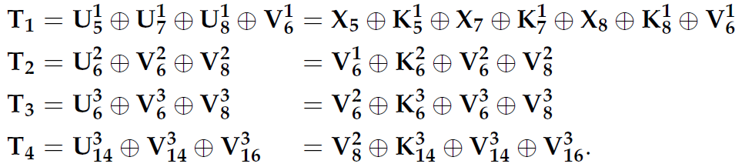

Linear Cryptanalysis
$ε\left(T1 ⨁ T2 ⨁ T3 ⨁ T4\right)$=$2^{3}\left(1/4\right){\left(−1/4\right)}^{3}=−1/{32}$
Right sides of the above equations:

Slide 21
Linear Cryptanalysis
The expression above only involves plaintext bits, bits of u⁴ and key bits.
Suppose the key bits are fixed. Then
has the (fixed) value 0 or 1.
It follows that
has bias -1/32 or 1/32 where the sign depends on the key bits (=0 or =1).

Slide 22
Linear Cryptanalysis
If the XOR of key bits is equal to 0, so the bias of the expression is not changed.
If the XOR of key bits is equal to 1, so the bias of the expression is:

Slide 23
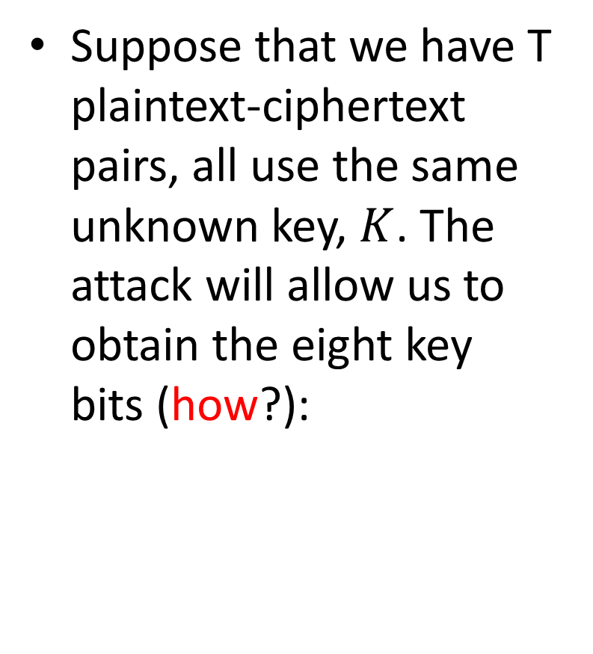
Linear Cryptanalysis
x
u¹
v¹
Suppose that we have T plaintext-ciphertext pairs, all use the same unknown key, $K$. The attack will allow us to obtain the eight key bits (how?):
w¹
u²
v²
w²
u³
v³
w³
u⁴
v⁴
y

Slide 24
Linear Cryptanalysis
There are 2⁸=256 possibilities for the eight key bits. We refer to a binary 8-tuple as a candidate subkey
For each and for each candidate subkey, we compute a partial decryption of y and obtain the resulting value for .
Then we compute the value

Slide 25
Linear Cryptanalysis
We make an array of counters indexed by the 256 possible candidate subkeys, and increment the counter corresponding to a particular subkey when below has the value 0.
In the end, we expect most counters will have a value close to T/2, but the correct candidate subkey will close to T/2±T/32.

Slide 26
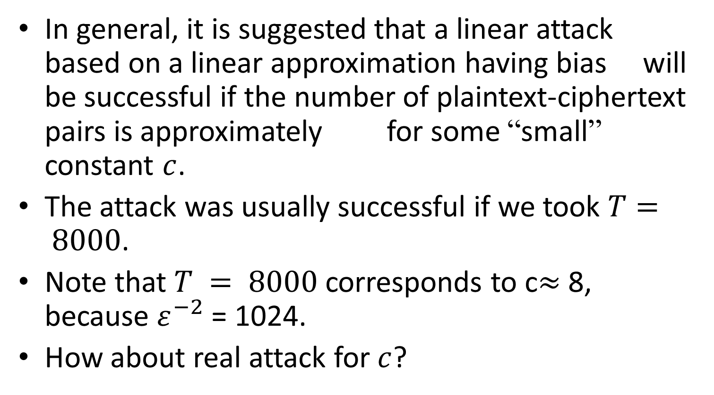
Linear Cryptanalysis
In general, it is suggested that a linear attack based on a linear approximation having bias will be successful if the number of plaintext-ciphertext pairs is approximately for some “small” constant $c$.
The attack was usually successful if we took $T= 8000$.
Note that $T = 8000$corresponds to c$≈$ 8, because $ε^{−2}$ = 1024.
How about real attack for $c$?

Slide 27
Public-key cryptography
Asymmetric cryptography, is the field of cryptographic systems that use pairs of related keys. Each key pair consists of a public key and a corresponding private key
Security of public-key cryptography depends on keeping the private key secret; the public key can be openly distributed without compromising security
In a public-key encryption system, anyone with a public key can encrypt a message, yielding a ciphertext, but only those who know the corresponding private key can decrypt the ciphertext to obtain the original message

Slide 28
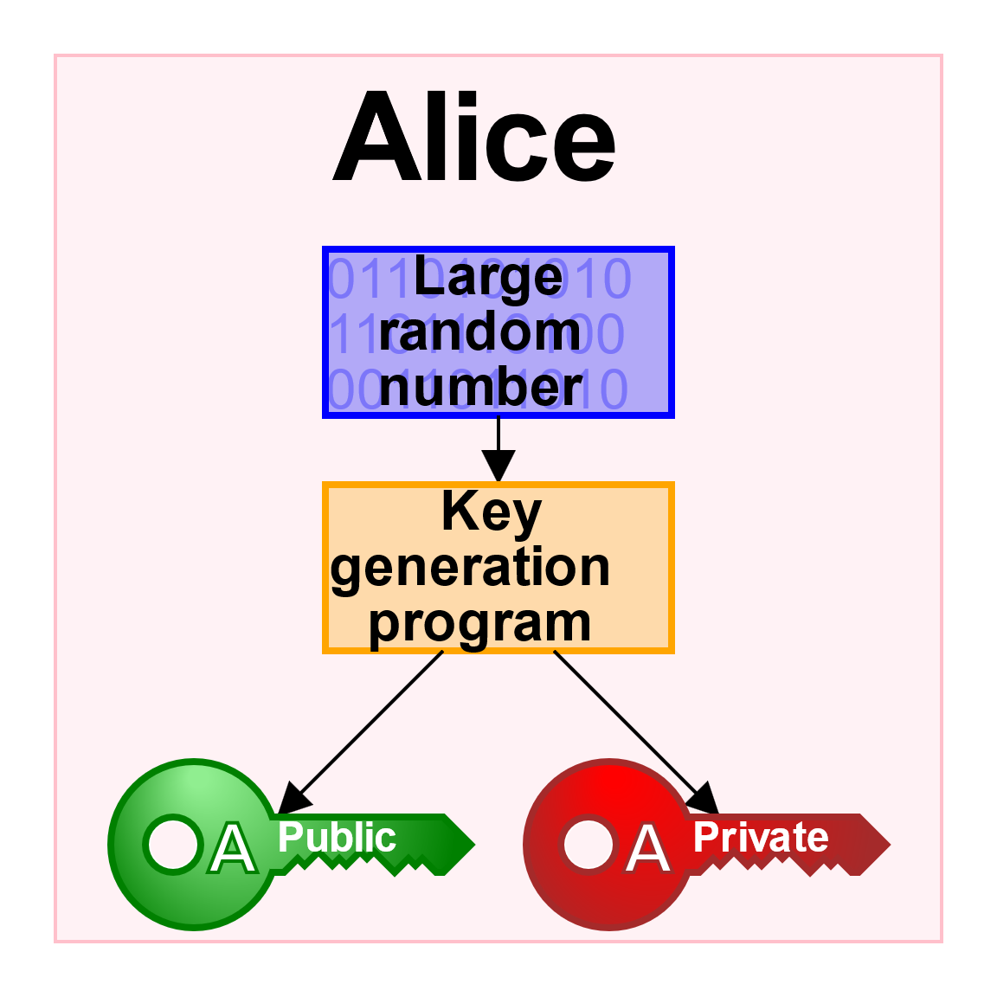
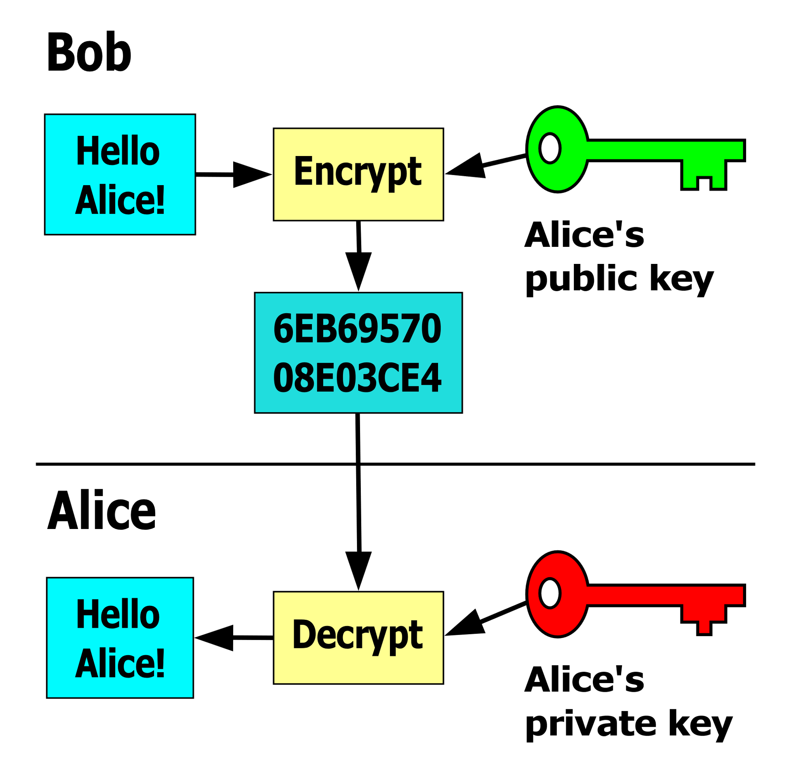
Public-key cryptography

Slide 29
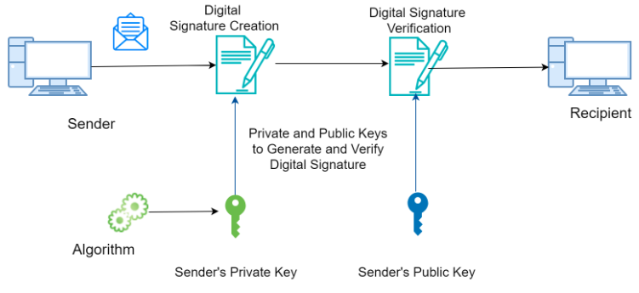
Digital signature

